Slide 1
A Brief Introduction to LaTeX for Scientific Writing
Mohammadhossein Farzanfar

Slide 2
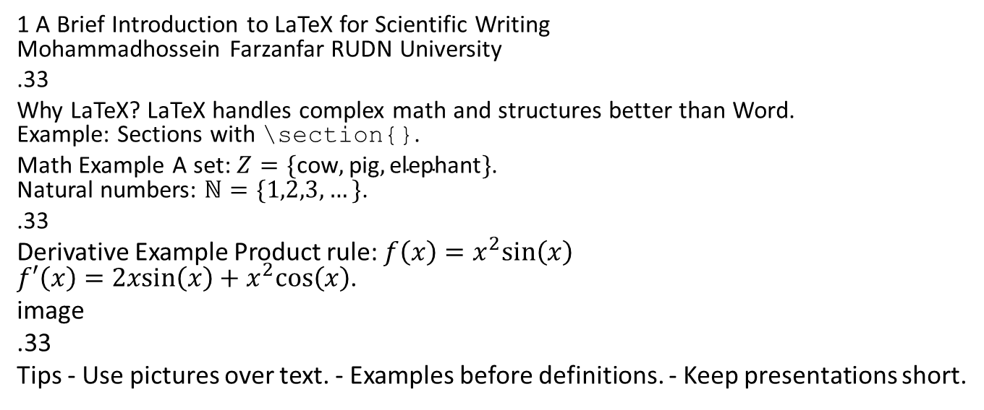
1 A Brief Introduction to LaTeX for Scientific Writing Mohammadhossein Farzanfar RUDN University
.33
Why LaTeX? LaTeX handles complex math and structures better than Word. Example: Sections with \section{}.
Math Example A set: $Z=\{\text{cow},\text{pig},\text{elephant}\}$. Natural numbers: $ℕ=\{1,2,3,…\}$.
.33
Derivative Example Product rule: $f\left(x\right)=x^{2}sin\left(x\right)$ $f′\left(x\right)=2xsin\left(x\right)+x^{2}cos\left(x\right)$.
image
.33
Tips - Use pictures over text. - Examples before definitions. - Keep presentations short.

